Slide 1
ImageNet Classification with Deep Convolutional Neural Networks
Alex Krizhevsky, Ilya Sutskever, Geoffrey E. Hinton

Slide 2
Abstract
model
60 million parameters
650,000 neurons
five convolutional layers, some of which are followed by max-pooling layers,
and three fully-connected layers with a final 1000-way softmax.
faster training
non-saturating neurons
a very efficient GPU implementation of the convolution operation
reduce overfitting in fully-connected layers
dropout

Slide 3
Introduction
CNN에게 좋은 환경
GPU의 발전
Label된 학습 데이터가 많아짐
standard feedforward neural networks with similarly-sized layers보다 CNN은
much fewer connections and parameters
easier to train
대신 이론적 결과는 좀 안 좋을 수 있다

Slide 4
Dataset
ImageNet
256 x 256에서 down-sample
pre-process는 안 함
단, subtracting the mean activity over the training set from each pixel

Slide 5
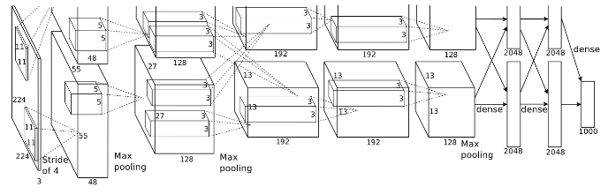
Architecture
5 Convs + 3 FC to 1000 classes
특이점들
ReLU Nonlinearity
Multiple GPUs
Local Response Normalization
Overlapping Pooling

Slide 6
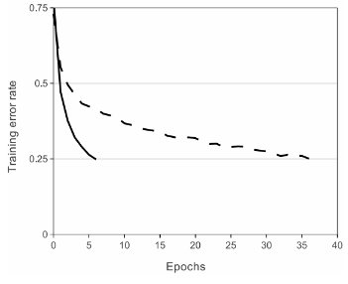
ReLU vs tanh
적은 epoch으로 수렴

Slide 7
Overall Architecture

Slide 8
Reducing Overfitting
Data Augmentation
Enlarge
Translations & Horizontal Reflections - 256 x 256에서 224 x 224 패치 랜덤 뜯어서 학습
RGB Pixel에 값 더하기
Dropout
Probability 0.5
roughly doubles the number of iterations required to converge
Overlapping Pooling

Slide 9
Details of Learning
Stochastic Gradient Descent
Hyperparameters
Batch Size 128
Momentum 0.9
Weight Decay 0.0005
learning rate - heuristic - 0.01 and divide 10 three times
roughly 90 cycles through the training set of 1.2 million images
five to six days on two NVIDIA GTX 580 3GB GPUs

Slide 10
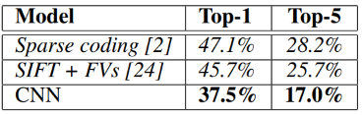
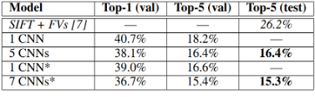
Results
ILSVRC-2010
ILSVRC-2012

Slide 11
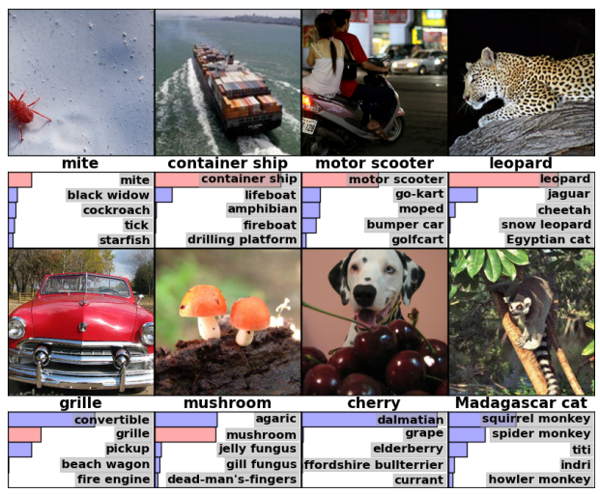
Qualitative Evaluations
GPU들 간의 Specialization이 일어나더라 (Color-Specific / Color-Agnostic)
Off-Center Object도 잘 잡더라
대부분의 top-5 라벨이 옳더라

Slide 12
Discussion
Depth is Really Important
중간 layer 하나 삭제하면 top-1 performance 2% 하락

